Slide 1
Quanvolutional Neural Networks
Hannah Graff

Slide 2
Introduction Part 1: QCNNs

Slide 3
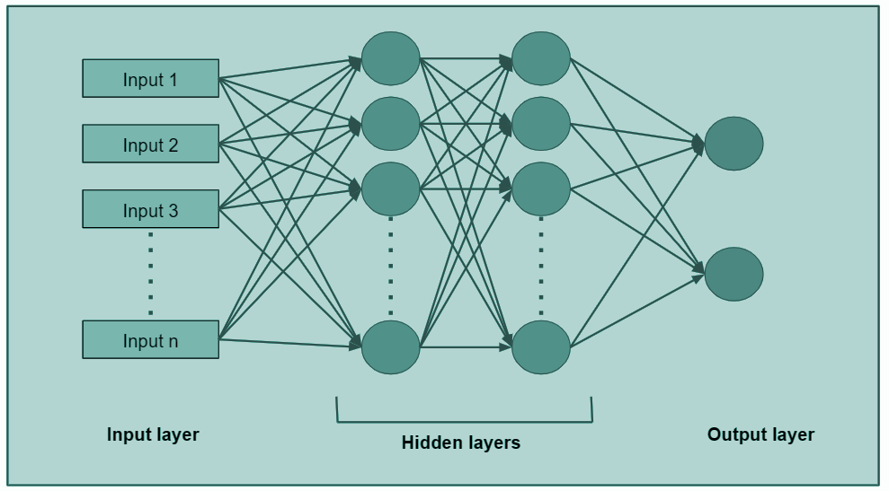
Introduction (Data Science)
Neural Network: a machine-learning algorithm that takes data as input, processes the data through hidden layers, and produces an output
Weights are assigned to different inputs
Notes:
Example: Surfing (crowded, shark attacks, and waves)
https://www.ibm.com/topics/neural-networks

Slide 4
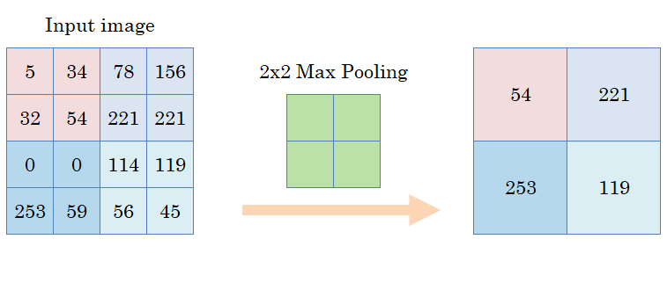
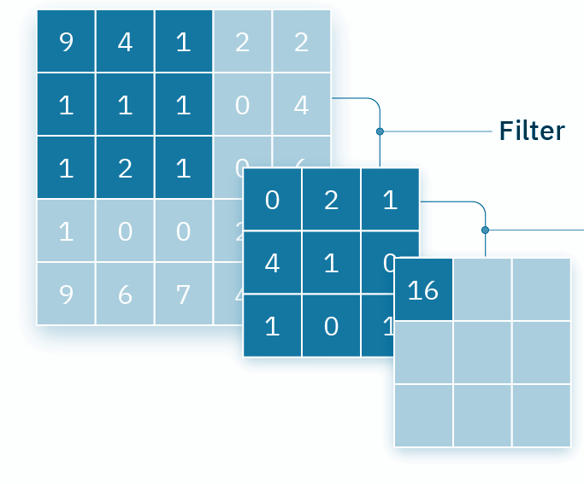
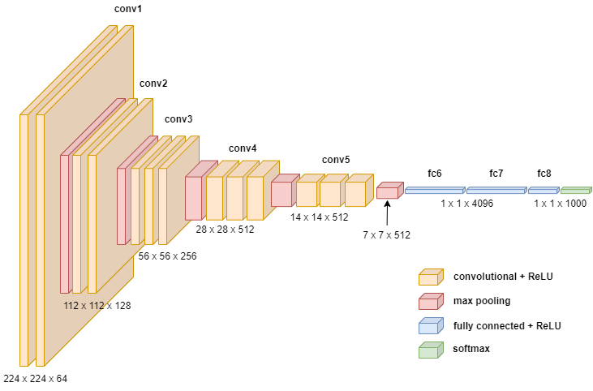
Introduction (Data Science)
Convolutional Neural Network (CNN): neural networks used for (image) classification using (1) a convolutional layer, (2) a pooling layer, and (3) a fully-connected (FC) layer
Notes:
Convolutional layer: hidden functions extracting features (requires input data, a filter, and a feature map)
Pooling: reduce dimension by deleting some information
Fully-connected: classification
ReLu: changed linear function so that negative values become zero
Image: https://www.linkedin.com/pulse/deep-dive-convolutional-neural-networks-cnns-linkedin-subramanian/
Filter image: https://www.ibm.com/topics/convolutional-neural-networks
Pooling Image: https://towardsdatascience.com/understanding-convolutions-and-pooling-in-neural-networks-a-simple-explanation-885a2d78f211

Slide 5
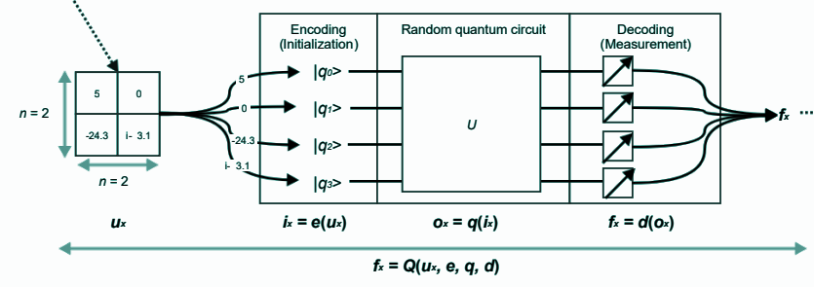
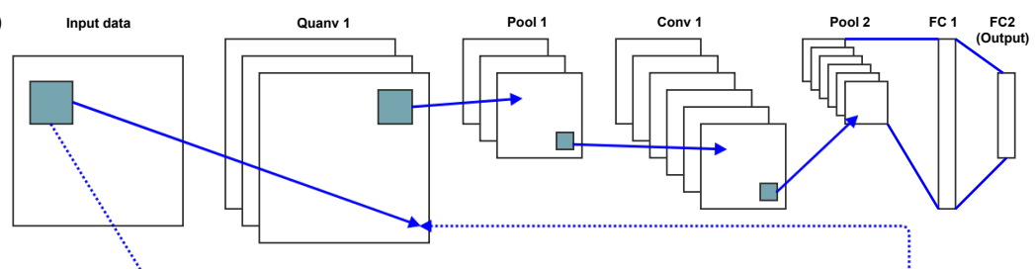
Introduction (Data Science)
Quanvolutional Neural Network: built on the CNN; instead of convolutional layers, quanvolutional layers transform the data using a number of random quantum circuits (like the filter function)
Notes:
Images from paper: https://arxiv.org/pdf/1904.04767

Slide 6
Motivation (Data Science)
CNNs are helpful for feature extraction from data
QCNNs produce meaningful feature classification and more
Useful for quantum computing in the future
Better accuracy, more efficiency, faster results
Notes:
Taken from: https://arxiv.org/pdf/1904.04767

Slide 7
Literature Review (Data Science)
“Quanvolutional Neural Networks: Powering
Image Recognition with Quantum Circuits”
Maxwell Henderson, Samriddhi Shaky, Shashindra Pradhan, and Tristan Cook
Dataset: MNIST dataset (70,000 28x28 greyscale pixel images.)
Methodology:
Split data 60,000/10,000 for training/testing
Define QNN filter
Encode and decode
Implement CNN, QNN, and Random model
Limitations:
QNN Limitations (e.g., large # of transformations)
“a massive number of practical questions need further research to bring the QNN functionality to its peak performance”
Notes:
https://arxiv.org/pdf/1904.04767

Slide 8
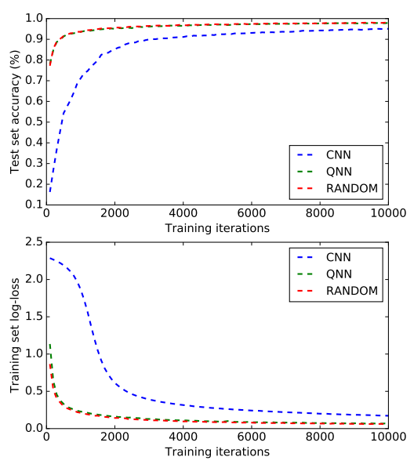
Literature Review (Data Science)
“Quanvolutional Neural Networks: Powering
Image Recognition with Quantum Circuits”
Maxwell Henderson, Samriddhi Shaky, Shashindra Pradhan, and Tristan Cook
Notes:
https://arxiv.org/pdf/1904.04767

Slide 9
Introduction Part 2: Deepfakes

Slide 10
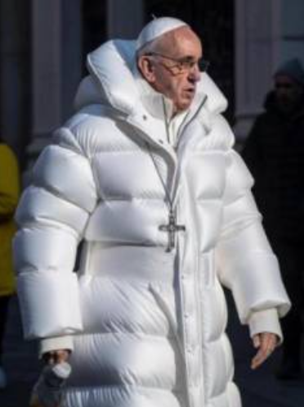
Introduction (Deepfakes)
Deepfake: artificially generated photo of a person
Deepfakes can create many problems, including:
Identity theft
Cyberbullying
Including pornographic content
Fake news dissemination
Threats to global security

Slide 11
Motivation (Deepfakes)
Not only has this technology created confusion, skepticism, and the spread of misinformation, deepfakes also pose a threat to privacy and security. With the ability to convincingly impersonate anyone, cybercriminals can orchestrate phishing scams or identity theft operations with alarming precision.”
-Stanford University
Notes:
Motivation
https://uit.stanford.edu/news/dangers-deepfake-what-watch#:~:text=Not%20only%20has%20this%20technology,theft%20operations%20with%20alarming%20precision.

Slide 12
Literature Review (Deepfakes)
“Detecting Deepfake Videos Using
Attribution-Based Confidence Metric”
Steven Fernandes, Sunny Raj, Rickard Ewetz, Jodh Singh Pannu, Sumit Kumar Jha, Eddy Ortiz, Iustina Vintila, Margaret Salter
Datasets: 3 original & 3 generated
Original: 2 from COHFACE and VidTIMIT datasets and 1 from YouTube.
Generated: 2 videos from COHFACE dataset and YouTube using a commercial website, and 1 using GANs
Combine original and donor video
Methodology:
Create/find the datasets
Apply the ABC-metric
Obtain cumulative data fraction and ABC plots
Notes:
https://openaccess.thecvf.com/content_CVPRW_2020/papers/w19/Fernandes_Detecting_Deepfake_Videos_Using_Attribution-Based_Confidence_Metric_CVPRW_2020_paper.pdf

Slide 13
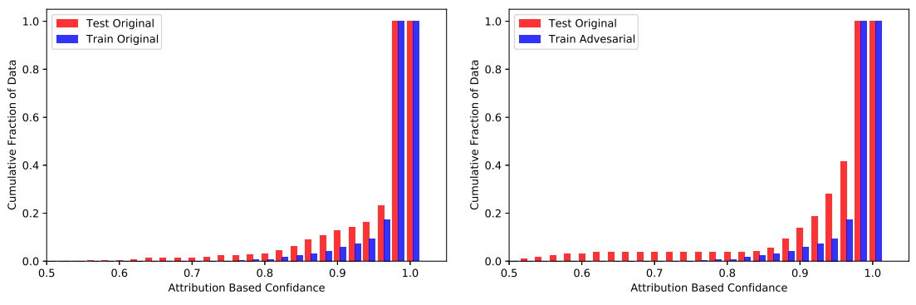
Literature Review (Deepfakes)
“Detecting Deepfake Videos Using
Attribution-Based Confidence Metric”
Steven Fernandes, Sunny Raj, Rickard Ewetz, Jodh Singh Pannu, Sumit Kumar Jha, Eddy Ortiz, Iustina Vintila, Margaret Salter
Limitations: None listed
Notes:
https://openaccess.thecvf.com/content_CVPRW_2020/papers/w19/Fernandes_Detecting_Deepfake_Videos_Using_Attribution-Based_Confidence_Metric_CVPRW_2020_paper.pdf

Slide 14
My Project

Slide 15
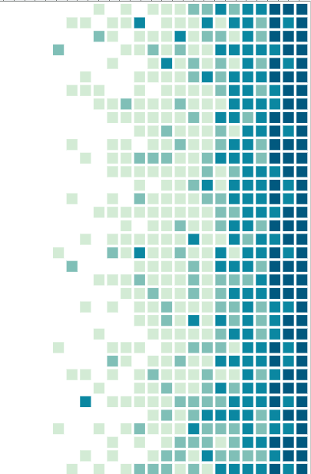
Project Objective:
Implement a quantum convolutional neural network (QCNN) model for deepfake detection

Slide 16
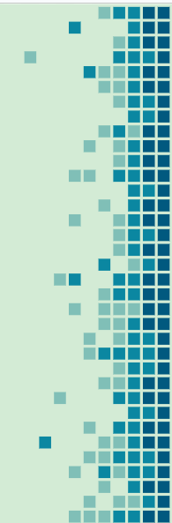

Project Approach
Goal
Enhance detection accuracy & processing efficiency against increasingly advanced deepfake videos
Generate commercial deepfake on platform
Use advanced generative AI techniques
Build the QNN
Implement QNN model on real and deepfake datasets
Comparative analysis with quantum transfer learning
Notes:
file:///C:/Users/hanna/Downloads/WiML_2%20(1).pdf
Replace 4 w/ evaluate model performance?
https://pennylane.ai/qml/demos/tutorial_quantum_transfer_learning/

Slide 17
Project Approach
Goal
Enhance detection accuracy & processing efficiency against increasingly advanced deepfake videos
Process:
Data
Preprocess
Model
Evaluate
Deployment
Strengths of the model:
Adapts effectively to the complexities of deepfake data
Handles high-dimensional data spaces
Performs complex transformations
Notes:
file:///C:/Users/hanna/Downloads/WiML_2%20(1).pdf
Data → Preprocess → Model → Evaluate → Deployment

Slide 18
Datasets
10 different datasets of videos
Comprised of original, donor, and fake
Fake combines original & donor
Generated using www.deepfakesweb.com
Notes:
file:///C:/Users/hanna/Downloads/WiML_2%20(1).pdf

Slide 19
Timeline
Weeks | Plan
1 & 2 | Learn about relevant research
3 & 4 | Begin to work with code for the model; decide structure of the model
5 & 6 | Make sure everything is working properly; run several of the models
7 & 8 | Evaluate model performance
9 & 10 | Gather data and make conclusions
Notes:
file:///C:/Users/hanna/Downloads/WiML_2%20(1).pdf

Slide 20
Conclusion
Quanvolutional Neural Networks (QNNs) are a faster way to classify data.
As AI is becoming more advanced, we need to develop better ways to detect deepfakes. We will apply this model to original, donor, and fake videos to enhance overall deepfake detection.
Notes:
file:///C:/Users/hanna/Downloads/WiML_2%20(1).pdf

Slide 21
Thank you!

Slide 22
References
Professional Articles:
Fernandes, S., Raj, S., Ewetz, R., Pannu, J.S., Jha, S.K., Ortiz, E., Vintila, I., and Salter, M., 2020. Detecting deepfake videos using an attribution-based confidence metric. In Proceedings of the IEEE/CVF Conference on Computer Vision and Pattern Recognition Workshops (pp. 308-309).
Henderson, M., Shakya, S., Pradhan, S., & Cook, T. (2020). Quanvolutional neural networks: powering image recognition with quantum circuits. Quantum Machine Intelligence, 2(1), 2.
Websites:
www.deepfakesweb.com
https://www.ibm.com/topics/convolutional-neural-networks
https://www.ibm.com/topics/neural-networks
https://towardsdatascience.com/understanding-convolutions-and-pooling-in-neural-networks-a-simple-explanation-885a2d78f211
https://pennylane.ai/qml/demos/tutorial_quantum_transfer_learning/
Notes:
file:///C:/Users/hanna/Downloads/WiML_2%20(1).pdf

Slide 23
Midterm Follow-up
Quantum Transfer Learning
https://pennylane.ai/qml/demos/tutorial_quantum_transfer_learning/
https://arxiv.org/pdf/1912.08278

